Slide 1
XInC2 Dev 2
Perf Spec
Adam Gulyas
January 15, 2021

Slide 2
XInC2 Dev 2
General Info
2021-01-07
The target audiences are university capstone groups and hobbyists.
Design choices will heavily weight compatibility with Arduino and Raspberry Pi ecosystems.
If possible, PCB design will be two layer, single sided.
PCB will be able to populate either EEPROM or Flash memory ICs through the use of common footprints and pin outs. Compatible part numbers for each type will be identified.

Slide 3
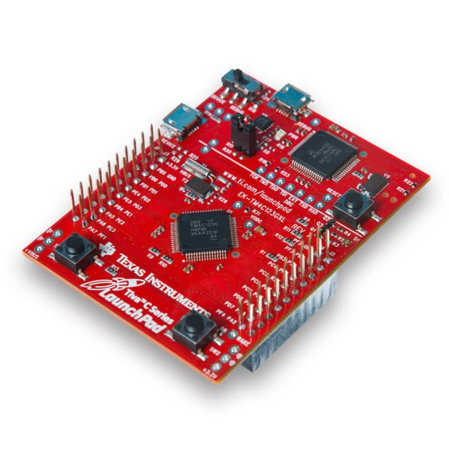
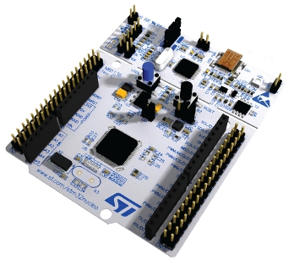
XInC2 Dev 2
Proposed Format
2021-01-07
General board format will follow the below examples:
Programmer at the top
uC bottom center
GPIO around the edge
A few buttons and LEDs

Slide 4
XInC2 Dev 2
Block Diagram
Rough PCB Layout
2021-01-07
No crystal pulling. Let the user use TMRB for something else.
Rough PCB Layout
USB
Type C
XPD3
components
USB
Type C
Data
XPD3
Lin. Reg.
RC Clk
RST
BTN
Flash or
EEPROM*
crystal
5V
SPI
XInC2
Lin.
Reg.
3.3V
XInC2
RC Clk
Header
Header
24.576 MHz
Crystal**
2x buttons
3 colour
LED
From XInC2 datasheet: The preliminary maximum clock speed at 3.3V for commercial conditions is 100MHz.”
RGB
LED
* Either population option possible
** Use a common crystal footprint to enable using other frequencies
2x button
RST button

